Slide 1
Innovations on breast reconstruction with tissue expanders
Annual Congress of National Cancer Institute – Cairo University
Cristiano Boneti, MD, FACS Plastic Surgery and Oncology Cancer Institute of America, Los Angeles

Slide 2
Disclosures
Consulting Agreement - AirXpanders
Consulting Agreement - Allergan

Slide 3
Dr Cristiano Boneti Introduction
18 Years of Medical Education
Board Certified General Surgeon (2010)
Fellowship Training In Diseases Of The Breast (2010)
University of Arkansas - Assistant Professor (2010-2012)
Board Certified Plastic Surgeon (2016)
University of Miami – Assistant Professor (2015-2018)
Director of Cancer Institute of America Los Angeles

Slide 4
Innovations On Breast Reconstruction
Prepectoral Implant Placement
Needle-Free CO2 Tissue Expander

Slide 5
History of Breast Reconstruction
1600 BC Egyptians Described In The Papyrus Writings
Galen Theorized BC Was Due “Coagulum Of Black Bile”
Virchow Proposed Tumor Arose From Epithelium And Spread Outward
Halsted Supported The “Regional” Phenomenon Theory
First Radical Mastectomy In 1889
Halsted Considered Reconstruction “A Violation Of The Local Control Of The Disease”

Slide 6
History of Breast Reconstruction
Cronin And Gerow Introduced The Silicone Gel Implant In 1963
1971 Snyderman And Guthrie Reported First Immediate Reconstruction Under The Remaining Mastectomy Skin
1982 Radovan Publish Initial Results With Tissue Expansion
Clouth And Collegues Reported A Liner Deterioration Of The Cosmetic Results, Where It Was “Acceptable” Initially But Less Desirable As Time Progressed – Asymmetry, Unpredictable Aging Of The Implants, High Infection Rates, High Wound Dehiscence and Exposure Rates

Slide 7
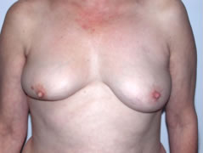
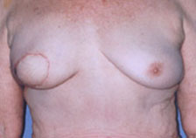
Halsted
MRM
BCS
Partial Skin Sparing

Slide 8
Epidemiology
American Society of Plastic Surgeons (ASPS) 2016 statistics
total number of reconstructive procedures – stable at million annually
the vast majority of these procedures include tumor removal such as office-based skin cancer excision
Breast reconstruction accounted for 109,256 procedures in 2016 or 1.9% of all reconstructive procedures
American Cancer Society estimates 252,710 new cases of invasive breast cancer in the United States in 2017
Steady annual growth in breast reconstruction over the years
39% increase in volume since 2000
3% increase since 2015
Today there are more than 3.1 million breast cancer survivors in the United States
Less than half of all women who require mastectomy are currently offered breast reconstruction surgery
Fewer than 20% elect to undergo immediate reconstruction
23% of women understand the wide range of breast reconstruction options available
The Breast Cancer Patient Education Act (BCPEA) was signed by President Obama in December 2015 and implemented in October 2016 to inform breast cancer patients about the availability and coverage of breast reconstruction and prostheses
There is still wide geographic variability associated with plastic surgeon density

Slide 9
Implant-Based Reconstruction
Implant Based Reconstruction Is The Most Used Technique In The EUA
Over 85000 Cases In 2015
Submuscular (Pectoralis + Serratus M) Or Partially Submuscular Are Most Commonly Used
American Society Of Plastic Surgery. 2015 Plastic Surgery Procedural Statistics. Available at: https://www.plasticsurgery.org/news/plastic-surgery-statistics
Sbitany H, Sandeen SN, Amalfi AN, Davenport MS, Langstein HN. Acellular dermis-assisted prosthetic breast reconstruction versus complete submuscular coverage: A head-to-head comparison of outcomes. Plast Reconstr Surg. 2009;124:1735-1740

Slide 10
Implant-Based Reconstruction
Techniques
Total Submuscular
Highly Dependent On Patient Anatomy
Dual-Plane Submuscular
Better Lower Pole Expansion
Better Control Of Pocket Size
Prepectoral
Eliminates Animation Deformity
More “Natural” Look
Highly Dependent On Mastectomy Flap Perfusion

Slide 11
Prepectoral Breast Reconstruction
Create A Subcutaneous Pocket For The Implant
Covered And Supported By Acellular Dermal Matrix and Skin
No Dissection Of The Muscle

Slide 12
Total Submuscular Coverage

Slide 13
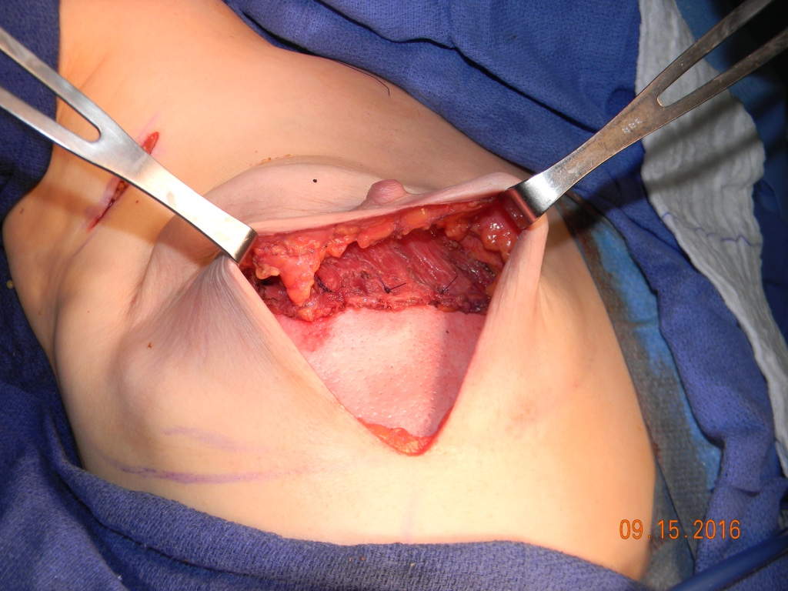
Dual-Plane Submuscular Reconstruction

Slide 14
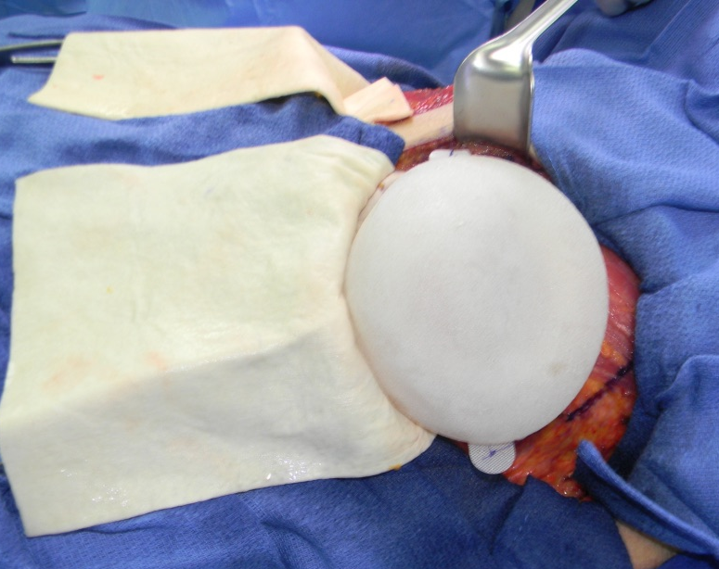
Prepectoral Reconstruction

Slide 15
Pre Pectoral Technique

Slide 16
Prepectoral Breast Reconstruction: A Safe Alternative to Submuscular Prosthetic Reconstruction following Nipple-Sparing Mastecotmy PRS: Sbitany et al 2017
 | Dual-Plane Submuscular | Prepectoral
Pts N | 115 | 51
N of Breasts | 186 | 84
Complications | 18.8% | 17.9%
Partial Nipple Loss | 1.6% | 2.4%
Skin Necrosis | 4.3% | 1.2%
Infection | 15% | 7.2%
TE Explantation | 4.3% | 1.2%
Postmastectomy Radiation | 17 | 7
Migration > 2 cm | 47% | 14%
Seroma | 11.8% | 14.3%
TE Explantation | 17% | 14%

Slide 17
Advantages:
Minimal morbidity
Reduced operative time
Multiple, shorter procedures
No donor site morbidity
Lack of additional scars
All flaps still available
Alternative to pts
Not surgical candidates for flap
Refuse flap recon

Slide 18
Disadvantages:
Complications of implant use
Ie. deflation, contracture, ripples
Contour irregularities
Does not behave like natural tissue
Generally limited by breast size
Largest implant 800cc
Relative contraindication in irradiated field
Resistant to expansion process

Slide 19
Implants after XRT
Dr. Kronowitz identified 19 studies, of varying quality, evaluating the results of implant-based reconstruction in patients receiving PMRT. He writes, "In general, radiation increases the risk of complications and poor aesthetic outcomes of implant-based reconstruction."
In one of the largest studies performed to date, the risk of major complications was about 45 percent for women receiving implants with radiation therapy, compared to 24 percent in patients not exposed to radiation. Complications were more common when radiation was given before versus after implant-based reconstruction: 64 versus 58 percent.
Kronowitz review in the October issue of Plastic and Reconstructive Surgery, 2012

Slide 20
Patient selection
Obesity as a relative contra-indication

Slide 21
Patient selection
Nipple-sparing mastectomy has superior aesthetic outcomes

Slide 22
Patient selection
Worse prognosis in the setting of moderate to severe radiation changes

Slide 23
Mastectomy Procedure: Most Important Step In Breast Reconstruction

Slide 24
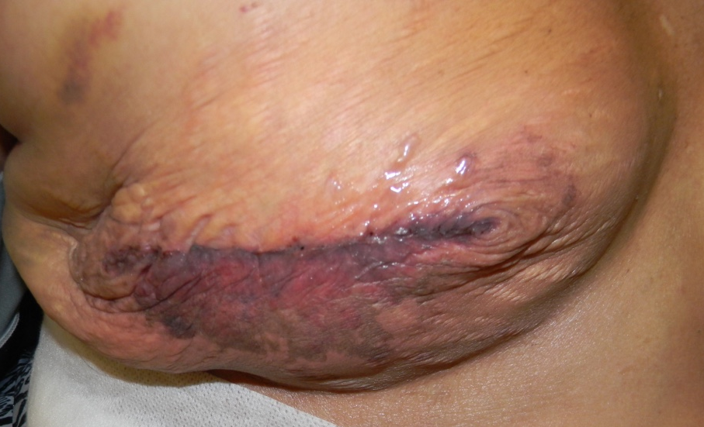
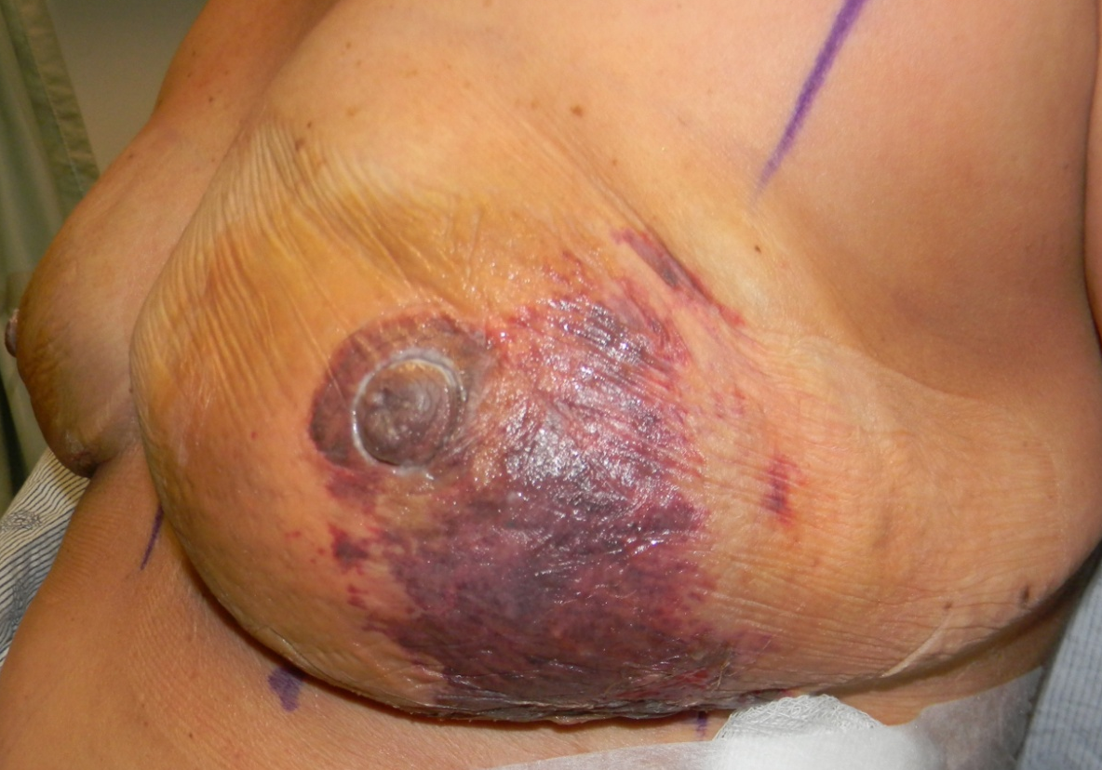
Probably not

Slide 25
ICG And Infrared Cameras
184 Patients
ICG Angiography Imaging Had
Lower Incidence Of Mastectomy Skin Necrosis (13% vs 23.4%; P = .010)
Lower Incidence Of Unexpected Reoperations For Perfusion-Related Complications (5.9% vs 14.1%, P = .009)
Duggal CS, Madni T, Losken A. An outcome analysis of intraoperative angiography for postmastectomy breast reconstruction. Aesthet Surg J. 2014 Jan 1;34(1):61-5.

Slide 26
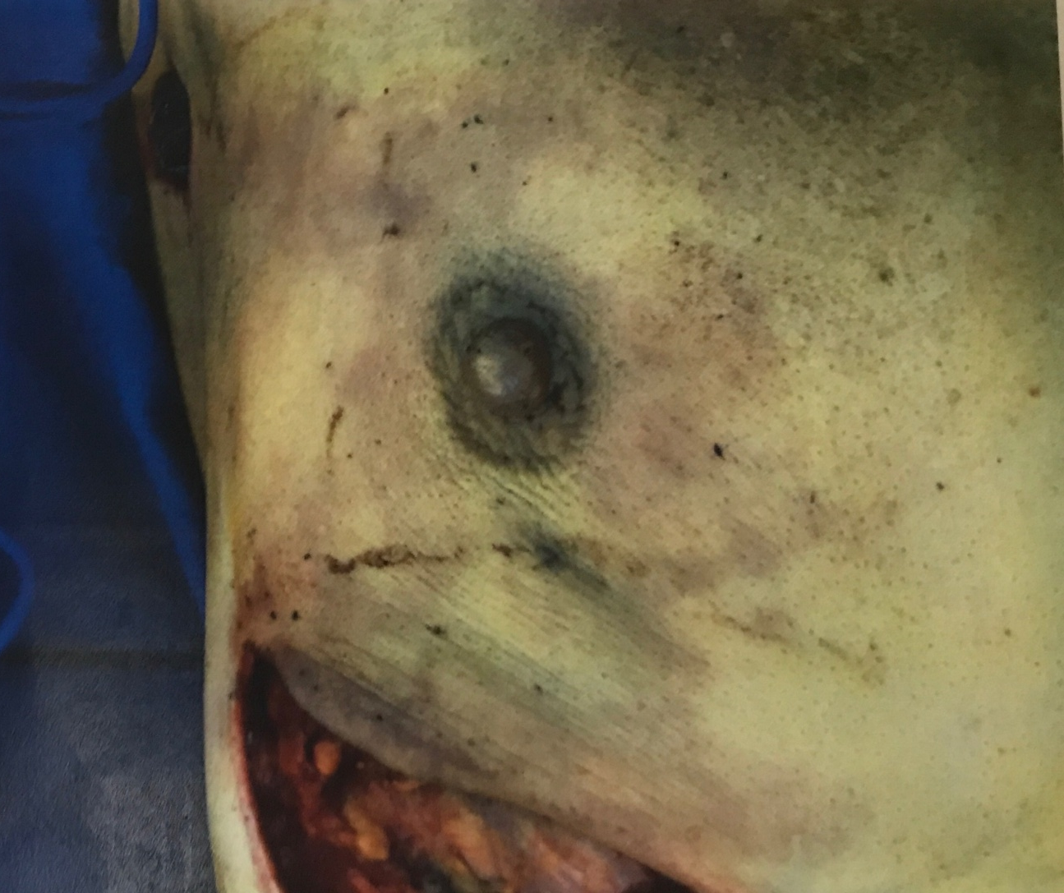
ICG And Infrared Cameras

Slide 27
Safety of ICG
Adverse reaction 1 in 42 000
Maximum dose 2 mg/kg

Slide 28
My Recommendations
Discuss Reconstruction Options With Every Patient
No Reconstruction
Implant-Based Reconstruction
Autologous Reconstruction
Combination (Autologous + Implants)

Slide 29
My Recommendations
Select Patients Carefully
Obese Patients Are Poor Candidates For Implant Based Reconstruction
Ptotic And Larger Breasts Reconstruct Better With Wise Pattern Scars And Nipple Repositioning

Slide 30
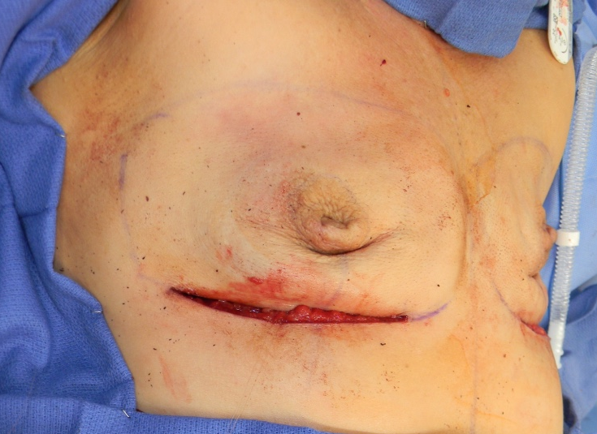
Intraoperatively
First Check Adequacy Of Mastectomy Flap Perfusion
ICG Angiography If Available

Slide 31
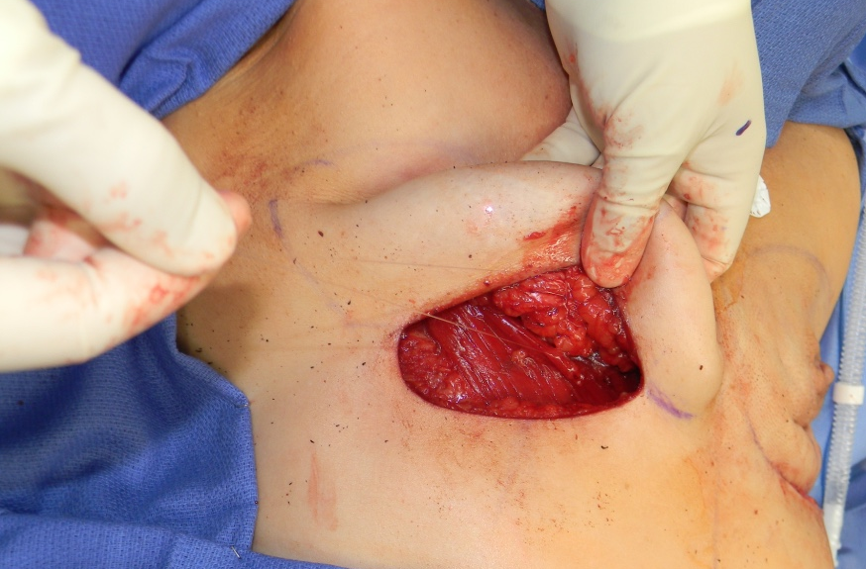
Intraoperatively
Centralize The NAC With Sutures Or Tegaderm

Slide 32
Nipple Centralization Technique

Slide 33
Intraoperatively
Position the NAC at the Center or Upper Half of the reconstructed breast volume

Slide 34
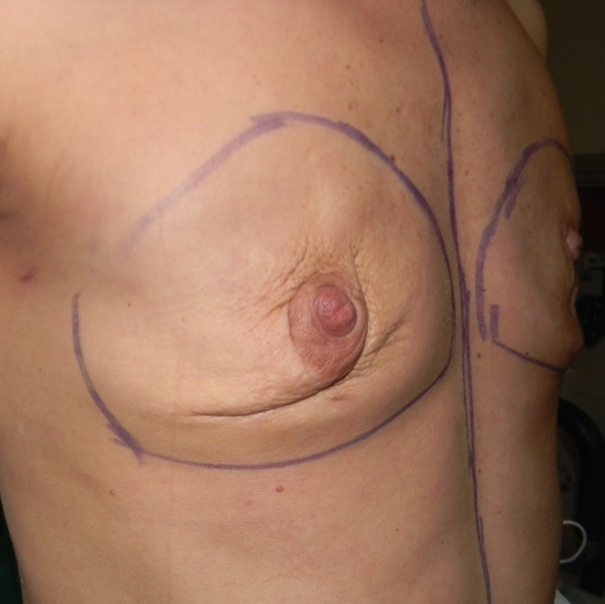
Nipple Sparing Mastectomy With Delayed Tissue Expander Reconstruction

Slide 35
Nipple Sparing Mastectomy With Delayed Tissue Expander Reconstruction

Slide 36
Prepectoral Reconstruction Direct To Implant
First Implant Selection
Breast Specimen Weight
Chest Width
Patient Desired Reconstruction Volume
Transpose Implant Base To Chest wall
Lateral Border Of The Sternum
IMF

Slide 37
Prepectoral Reconstruction Direct To Implant
Sew ADM To Cover The Implant
Ensure 2 Cm Fold At IMF
Adhere To CW and Mastectomy Flap

Slide 38
Prepectoral Reconstruction Direct To Implant
Cover Skin To Avoid Contact With The Implant
Place The Implant Between ADM And Pec Major

Slide 39
Prepectoral Reconstruction Direct To Implant
Close Over Drains

Slide 40
A systematic review of complications associated with direct implants vs. tissue expanders following Wise pattern skin-sparing mastectomy. JPRA Corban J et al
561 direct-to-implant or two-step breast reconstruction procedures
Direct-to-implant reconstruction appears to be associated with an increased rate of overall complications and skin flap necrosis (30% vs 20.3%)
Skin flap necrosis (9.70%, 4.69%), delayed wound healing (2.77%, 0.78%), infection (2.54%, 3.91%), seroma (1.15%, 4.68%), and hematoma (0.92%, 0.78%)
Placement of a de-epithelialized dermal flap may help limit delays in wound healing and infection

Slide 41
Needle-Free CO2 Tissue Expander

Slide 42
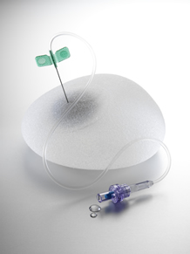
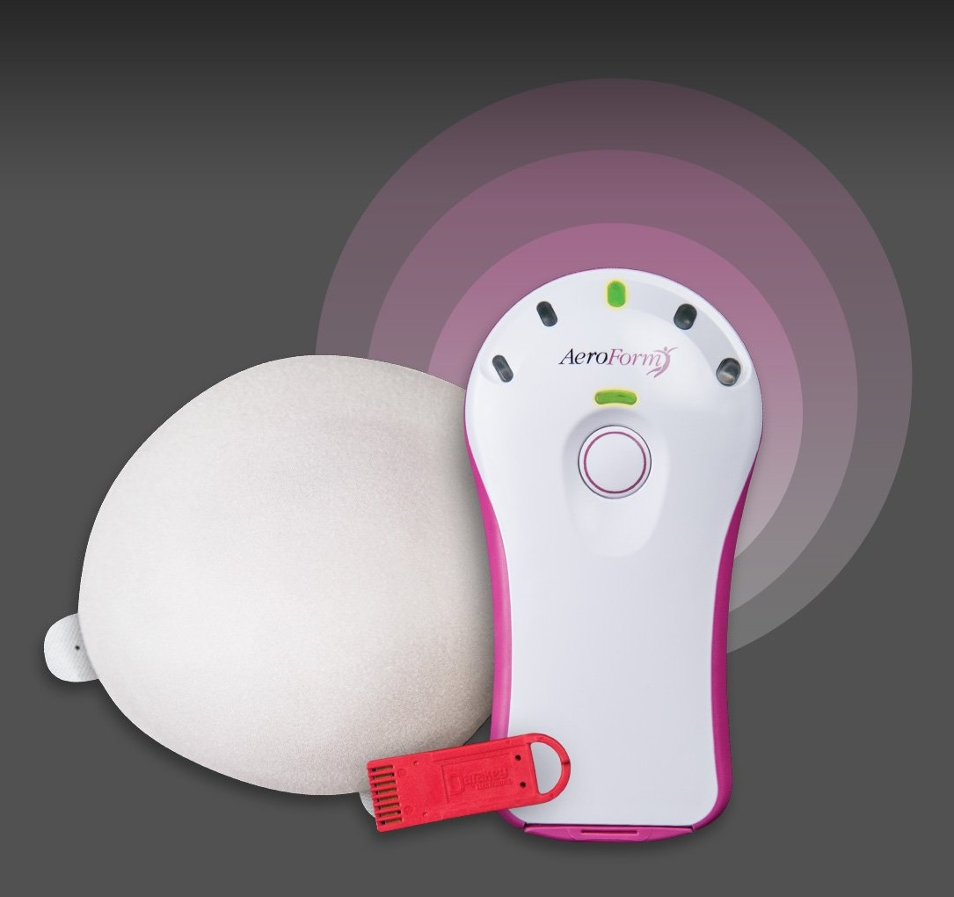

Slide 43
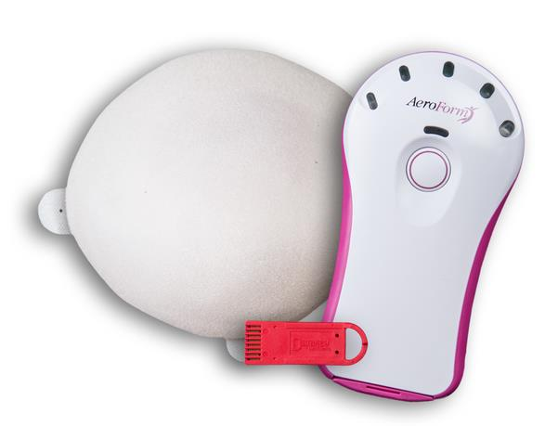
Carbon-dioxide-based Tissue Expander
AeroForm® - the first and only needle-free tissue expander system
Features
Internal component contains compressed CO₂ gas
Wireless, remote controlled gas release (Dosage Controller)
Physician or patient needle-free expansion
Form stable, anatomical shape
Focused lower pole projection
Light weight at full volume
Size | Vol | Width | Height | Projection
Small | 400cc | 12.5 cm | 11.0cm | 8.0cm
Medium | 600cc | 14.0 cm | 12.5cm | 9.5cm
Large | 800cc | 15.5 cm | 14.0cm | 10.5cm

Slide 44
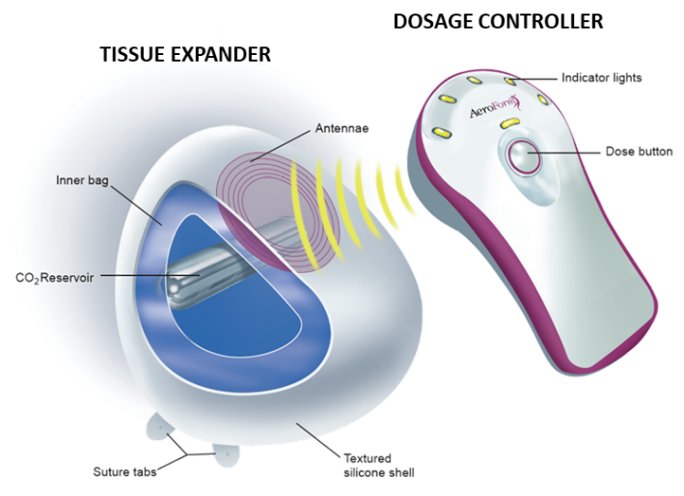
How AeroForm Works
Magnetically-Activated Microvalve Technology
Dosage Controller syncs with the Expander via RF
Powers the proprietary Microvalve system inside Expander
Activates release of 10cc of CO₂
Patient lockout for 3 hrs
Maximum of 3 doses per 24-hour period
No on-board electrical power in Expander

Slide 45
Clinical Data Summary
Study | n= | No. of Implants | Avg Expansion Time (Days) | Reconstruction Days | Patient / Surgeon Satisfaction Rates | Significance
PACE (AU) | 7 | 10 | 15 | 110 | 100% | PACE-Feasibility study 100% overall successful expansion and exchange in PACE trials and 94% in ASPIRE trial (no device related failures) Studies enabled: CE Mark TGA Approval FDA Approval for IDE
PACE II (AU) | 33 | 61 | 17 | 90 | 98%
ASPIRE (AU) | 21 | 34 | 22 | 96 | 95%
XPAND (US) | 98 AeroForm 52 Saline | 168 AeroForm 88 Saline | 21 AeroForm (median) 46 Saline (median) | 108/136 | 84% / 83% | 2:1 Multi-center randomization Similar patient and procedural characteristics No statistically significant difference in AEs AeroForm v2.5
XPAND II (US) | 50 | 86 | 21 | 112 | 96% / 96% | Prospective, single arm, multi-center IDE study Data confirms results of the pivotal IDE study (XPAND) AE rate similar to previous results Submitted for publication September 2018
Connell AF. Patient-Activated Controlled Expansion for Breast Reconstruction with Controlled Carbon Dioxide Inflation: A Feasibility Study. Plast Reconstr Surg. 2011; 128 (4): 848-852.
Connell TF, Patient-Activated Controlled Expansion for Breast Reconstruction Using Controlled Carbon Dioxide Inflation: Confirmation of a Feasibility Study. Plast Reconstr Surg. 2014; 134(4): 503e-511e.
Connell, TF. Results from the ASPIRE study for breast reconstruction utilizing the AeroForm™ patient controlled carbon dioxide-inflated tissue expanders. Journal of Plastic, Reconstructive and Aesthetic Surgery (JPRAS) 2015 (1-7); http: //dx.doi.org/10.1016/j.bjps.2015.05.001.
Ascherman JA, et al. Carbon Dioxide-Based versus Saline Tissue Expansion for Breast Reconstruction; Results of the XPAND Prospective, Randomized Clinical Trial. Plast Reconstr Surg. 2016: Dec; 138 (6): 1161-1170.
Notes:
Note: low satisfaction rates in XPAND due primarily to permeation in v 2.0 and 2.5 TEs
XPAND II utilized v 2.5

Slide 46
Patient Benefits
Flexible – Physician and patient can determine dosing regimen
Convenient - Patient can dose wherever and whenever she chooses
Comfortable - Needle free, expand gradually based on comfort with small 10 cc doses
Rapid – reduces expansion time from months to weeks¹ which may allow for implant exchange ahead of radiation
1 Ascherman, J., et al. CO2-based vs. Saline Tissue Expansion for Breast Reconstruction: Results of the XPAND Prospective, Randomized Clinical Trial. Plastic and Reconstructive Surgery. Dec 2016 – Vol 138, No 6.

Slide 47
Saline Filled Tissue Expanders
Saline Filled Tissue Expanders:
Have Wide Variety Of TE And Similar Implant:
Low profile TE => Low profile Implant
Moderate profile TE => Moderate profile Implant
High profile TE => High profile Implant
Allows Overexpansion
Volume Of The Parts Is Minimal => Does Not Require Extra Skin For Placement

Slide 48
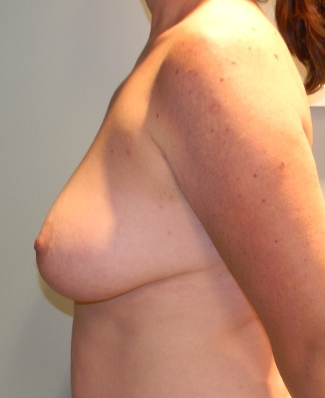
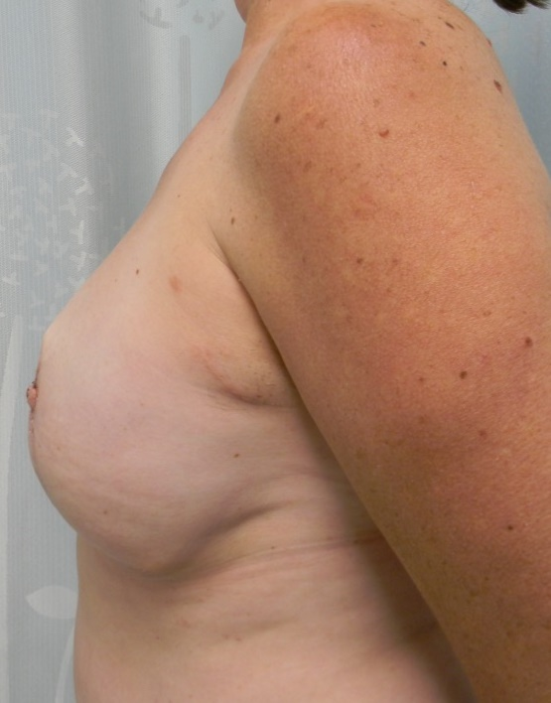
Saline Expander Limitations:
Aesthetically: Lack of Projection

Slide 49
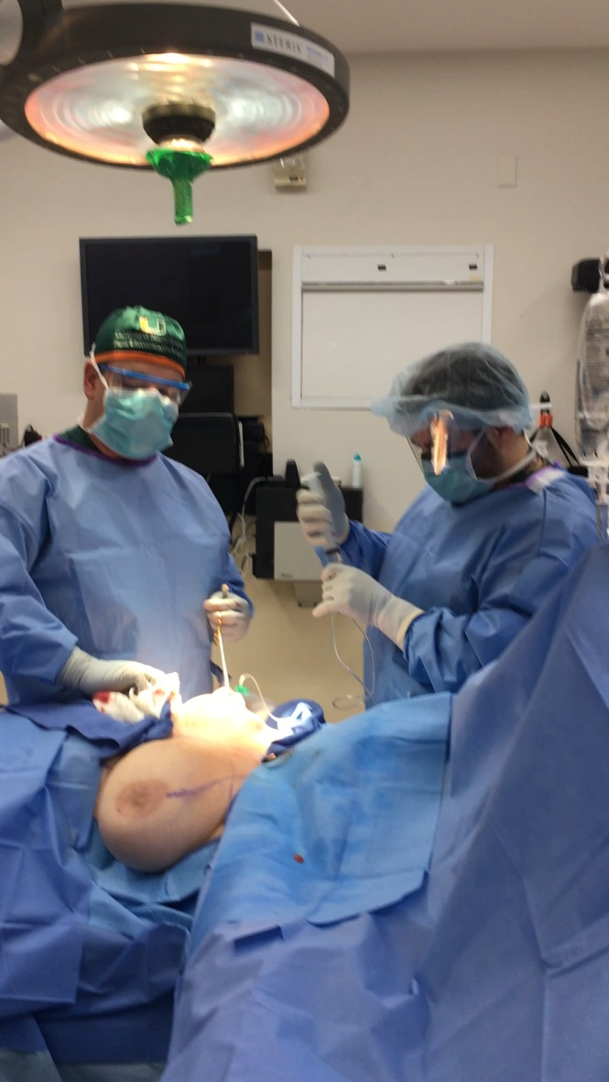
Saline Expander Limitations
Labor Intensive During Surgery:
Deflation of expanders
Reinflation to desired volume
Need for additional set up
Adds 15 to 20 minutes of surgery per side
Labor in clinic:
Postop visits for expansion takes approximately 30 minutes
Facility cost $209
Requires multiple postop visits:
Average 5 to 10 expansions

Slide 50
Needle-Free CO₂ Tissue Expander
Disruptive Technology
Limitations:
Minimal set up required in OR
Postop visits limited to wound check and expansion progress
Patient Comfort
Reduced expansion interval
Improves aesthetic result by improved projection
Component volume requires extra skin for placement
Rigidity
Does not allow over expansion
Limited volume range

Slide 51
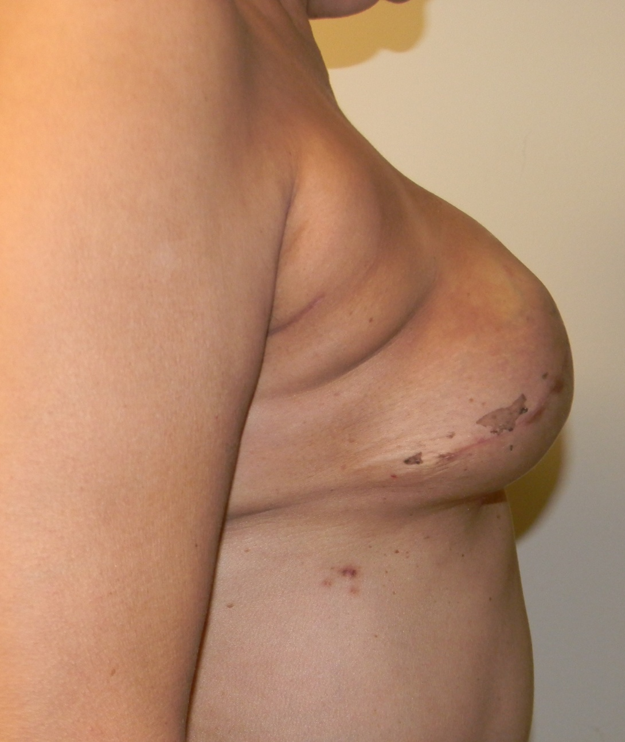
Improved Projection
Saline Expanders
AeroForm

Slide 52
Improved Projection

Slide 53
TE => Implant Exchange Planning
During initial reconstruction: select TE based on breast width
Instruct the patient to expand to desired volume
Select implants volume is easy => predictable based on expansion volume
Select implant projection based on patient desired breast shape

Slide 54
TE Silicone Implant

Slide 55
My Experience
August to December 2017:
35 Pts, 25 Bilateral, 10 Unilateral: Total of 60 Breast Reconstructions
Average Age 50.8 ± 12.4 Years, BMI 26.2 ± 5.3.
Indications:
83% Immediate Breast Reconstruction After Breast Cancer
12% Immediate Breast Reconstruction After Prophylactic Mastectomy
3% Delayed Breast Reconstruction

Slide 56
My Experience - Complications
Mastectomy flap necrosis – 20% (7/35)
Including 2 subjects who had previous radiation to the chest wall
5 of which resumed expansions after debridement and completed reconstruction
2 required the tissue expander removal (2/35 or 5.7%)
Large Volume Seroma 8.5% (3/35)
All 3 healed well, no drainage required
No infections
Prepectoral Breast Reconstruction: A Safe Alternative to Submuscular Prosthetic Reconstruction following Nipple-Sparing Mastectomy PRS: Sbitany et al 2017

Slide 57
My Practice
Before AeroForm
After AeroForm
Clinic:
15 to 20 pts per day
8 to 10 hours of clinic
6 to 7 expansions per day
OR
45 min to 1 h per breast reconstruction
Clinic:
22 to 30 pts per day
6 to 7 hours of clinic
No more expansions
Now able to add 1 to 3 cases after clinic
OR
30 min per breast reconstruction

Slide 58
Preop Postop

Slide 59
Breast Reconstruction After Needle-Free, CO₂ Tissue Expansion

Slide 60
Conclusions
New Advances In Technique
Improved Aesthetic Result
Reduced Surgical Time
Reduced Patient Discomfort
New Technology
Improved Patient Comfort
Reduced The Number Of Office Visits
Safer ? - Avoids Repeated Needle Sticks During Expansion

Slide 61
Thank You!

